Slide 1
Addressing phase noise issues in FMCW Lidar
Taehwan Kim
10/16/17

Slide 2
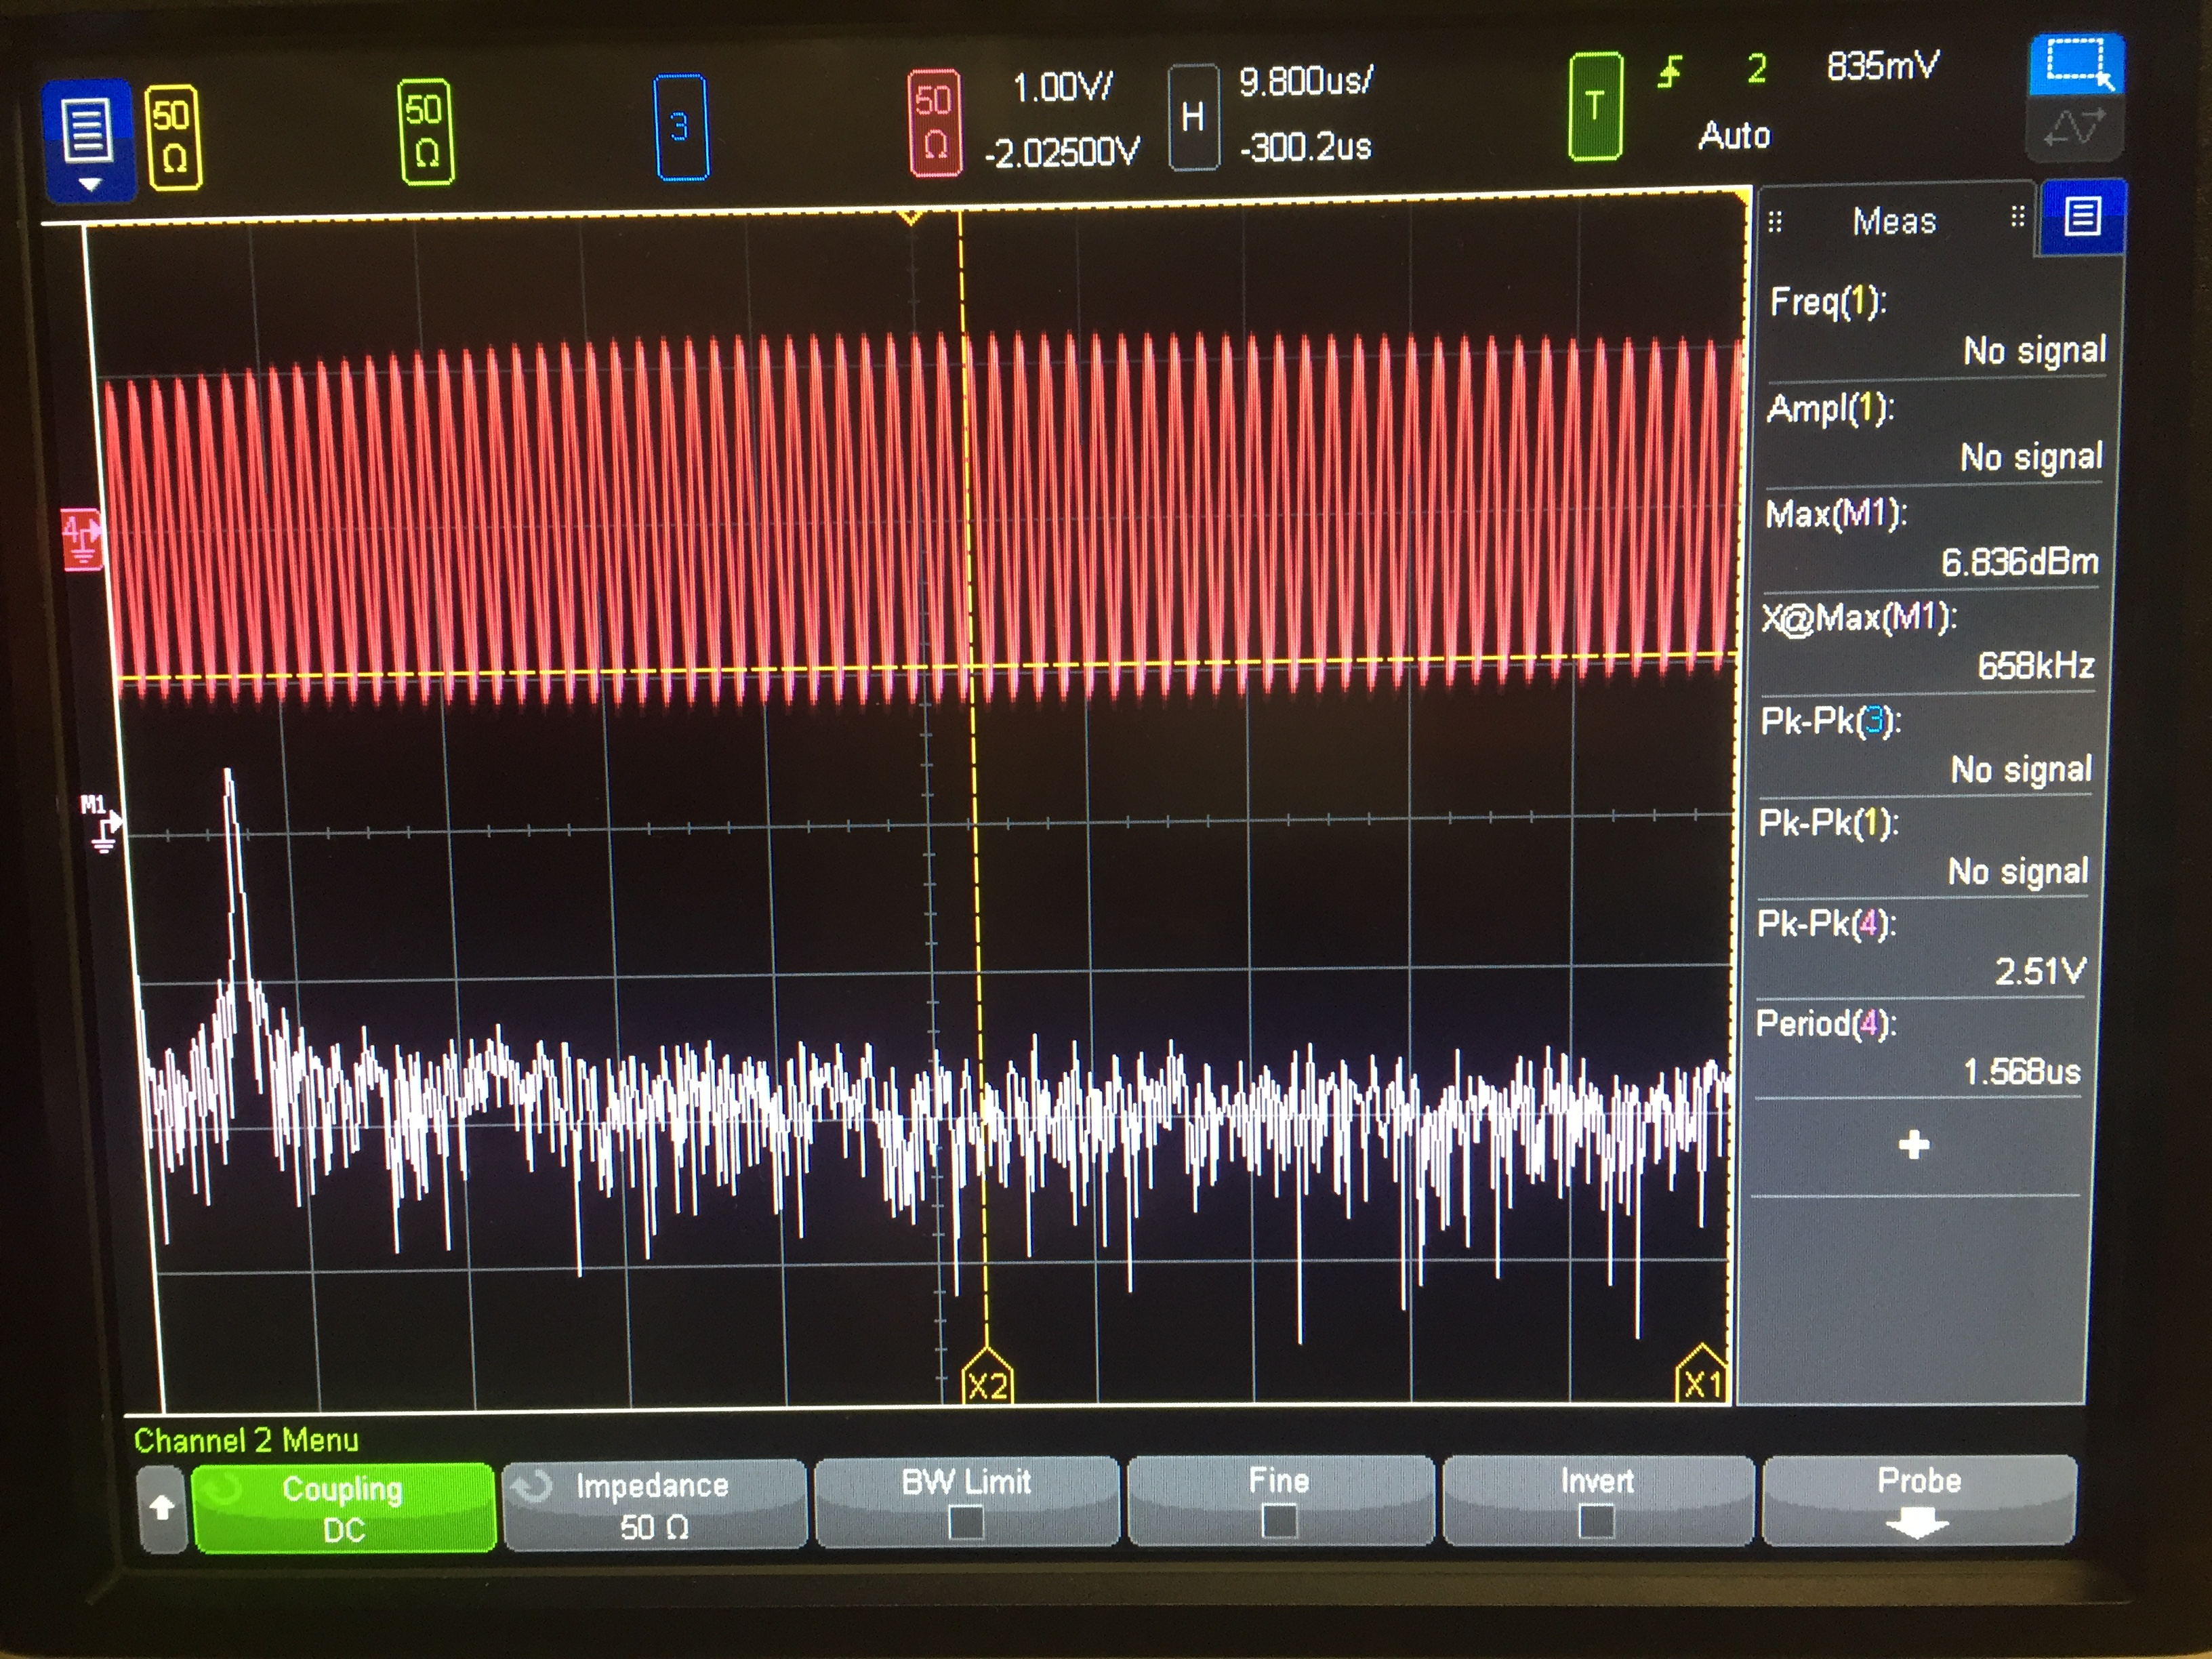
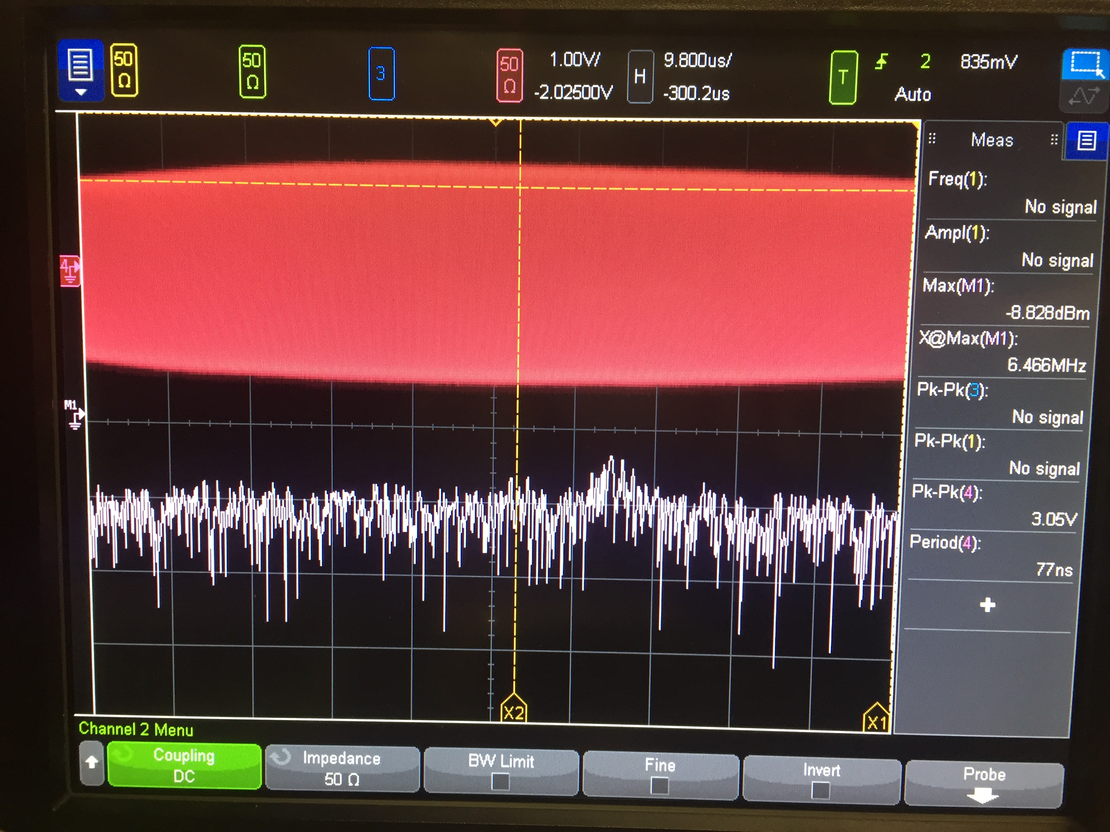
Impact of phase noise on FMCW LIDAR
Linewidth=1MHz, T=10us
20cm
2m
As 𝜏 goes up, PN of TX/RX beams are less correlated (less coherent)
Beating tone becomes weaker & noise pedestal go up
Cross @ 82m

Slide 3
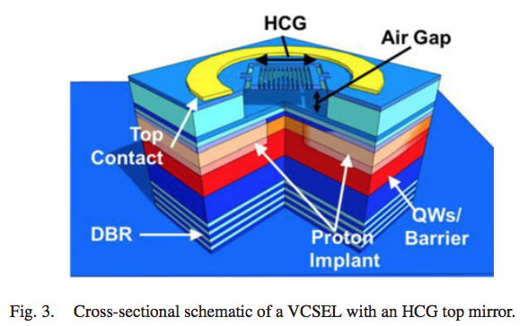
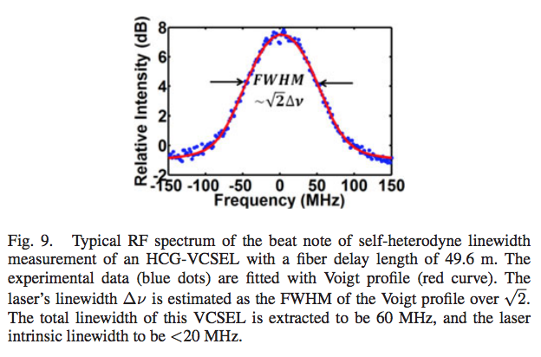
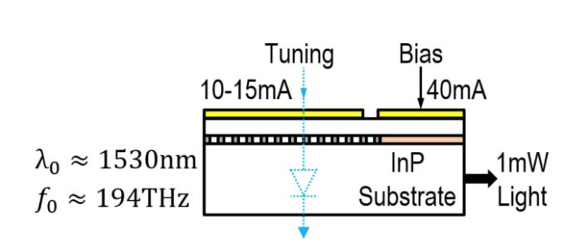
Nature of phase noise in tunable lasers
The common source of phase noise in lasers is spontaneous emission in the cavity
White frequency noise (noise density 𝛥𝜈 (Hz²/Hz)=Linewidth)
Coherence time (𝜏_{c}) = 1/Linewidth, coherence length = c𝜏_{c}
Actual laser has other noise sources
Especially tuning function can add various noise mechanisms
Phase noise density
Frequency
MEMS mirror VCSEL
DBR laser
Notes:
S_i(f) = \frac{{i_0}^2}{2}\left[ \frac{{\tau}_c/(2\pi)}{1+\left(\pi f {\tau}_c \right)^2} \left\{ 1- e^{-\frac{2\tau}{{\tau}_c}} \left[ \cos(2\pi f\tau) + \frac{1}{\pi f \tau_c} \sin(2\pi f \tau) \right] \right\} \right]
\tau_c = \frac{2}{\textrm{linewidth}},\quad i_0: \textrm{nominal photocurrent amplitude},\quad \tau: \textrm{path delay}

Slide 4
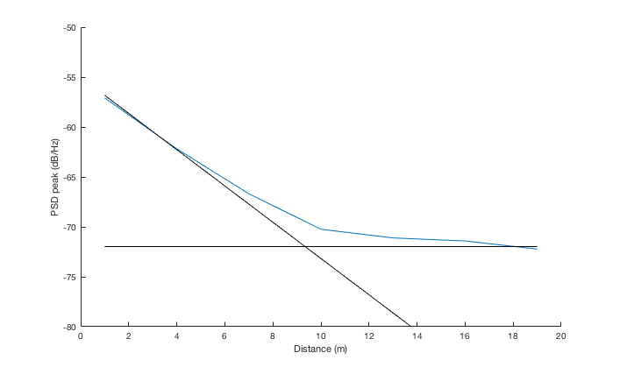
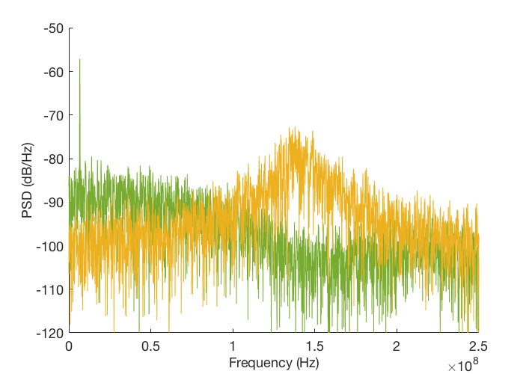
Phase noise example
Photocurrent PSD from theory
Even without shot noise, ranging accuracy is fundamentally limited by PN
Beyond coherence length (tau>tau_c), it’s just Lorentzian lineshape + shot noise floor
Linewidth: 10MHz
Scan time: 10us
Even beyond coherence range, it is still possible to estimate the distance from Lorentzian lineshape (just less accurate)
Beyond coherence range, PSD peak height is constant (function of linewidth)
1m
20m
Phase noise pedestal peak
Signal power
Notes:
S_i(f) = \frac{{i_0}^2}{2}\left[ \frac{{\tau}_c/(2\pi)}{1+\left(\pi f {\tau}_c \right)^2} \left\{ 1- e^{-\frac{2\tau}{{\tau}_c}} \left[ \cos(2\pi f\tau) + \frac{1}{\pi f \tau_c} \sin(2\pi f \tau) \right] \right\} \right]
\tau_c = \frac{2}{\textrm{linewidth}},\quad i_0: \textrm{nominal photocurrent amplitude},\quad \tau: \textrm{path delay}

Slide 5
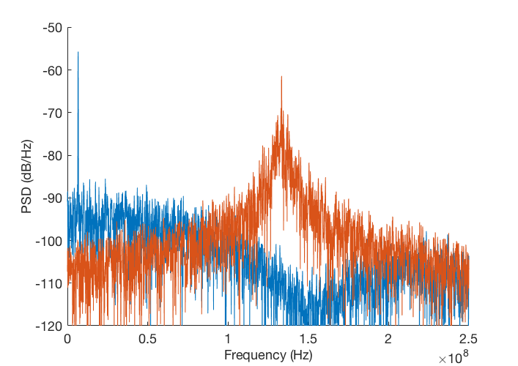
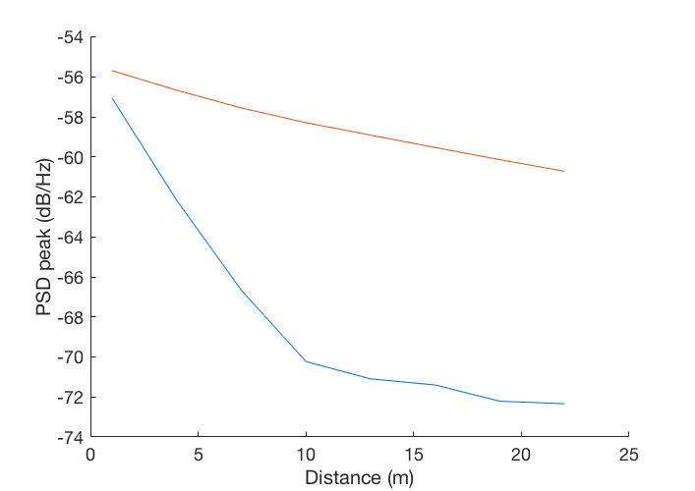
Phase noise example
1m
Scan time: 10us
20m
Linewidth: 2MHz²/Hz
1m
Linewidth: 10MHz²/Hz
20m
Notes:
S_i(f) = \frac{{i_0}^2}{2}\left[ \frac{{\tau}_c/(2\pi)}{1+\left(\pi f {\tau}_c \right)^2} \left\{ 1- e^{-\frac{2\tau}{{\tau}_c}} \left[ \cos(2\pi f\tau) + \frac{1}{\pi f \tau_c} \sin(2\pi f \tau) \right] \right\} \right]
\tau_c = \frac{2}{\textrm{linewidth}},\quad i_0: \textrm{nominal photocurrent amplitude},\quad \tau: \textrm{path delay}

Slide 6
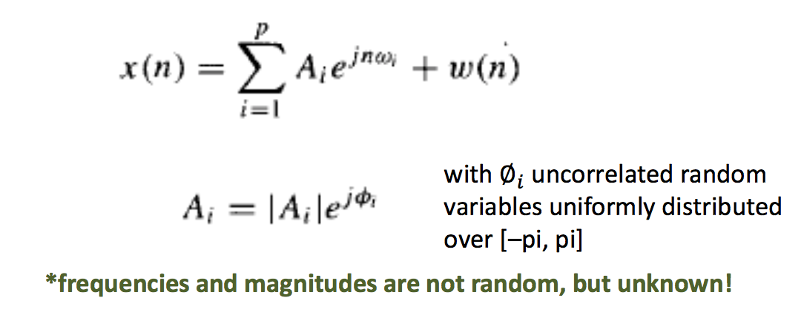
Phase noise problem: algorithm
Common belief: targets should always be within the coherence range
Significantly constrains linewidth spec for tunable laser
Backend: need to solve line spectral estimation problem
Common signal model:
In our case, phase term is actually random, and it is known that existing estimation algorithms perform poorly in presence of strong phase noise*
A. Barbieri, D. Bolletta and G. Colavolpe, GLOBECOM '05. IEEE Global Telecommunications Conference, 2005., 2005, pp. 5 pp.-.
Notes:
S_i(f) = \frac{{i_0}^2}{2}\left[ \frac{{\tau}_c/(2\pi)}{1+\left(\pi f {\tau}_c \right)^2} \left\{ 1- e^{-\frac{2\tau}{{\tau}_c}} \left[ \cos(2\pi f\tau) + \frac{1}{\pi f \tau_c} \sin(2\pi f \tau) \right] \right\} \right]
\tau_c = \frac{2}{\textrm{linewidth}},\quad i_0: \textrm{nominal photocurrent amplitude},\quad \tau: \textrm{path delay}

Slide 7
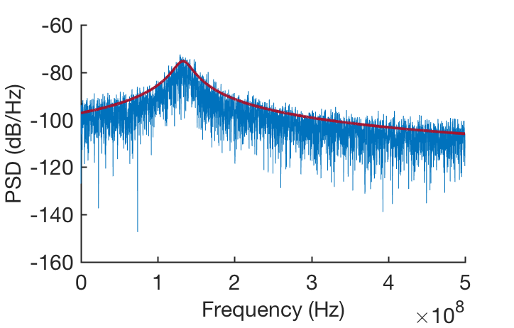
Phase noise problem: improved algorithm
If we can assume there’s single scatterer, we can fit the PSD estimate to the known shape (Lorentzian + white background) to get better distance estimate than just FFT → peak-finding
Given prior:
Signal model:
Least-squares solution:
Notes:
S_i(f) = \frac{{i_0}^2}{2}\left[ \frac{{\tau}_c/(2\pi)}{1+\left(\pi f {\tau}_c \right)^2} \left\{ 1- e^{-\frac{2\tau}{{\tau}_c}} \left[ \cos(2\pi f\tau) + \frac{1}{\pi f \tau_c} \sin(2\pi f \tau) \right] \right\} \right]
\tau_c = \frac{2}{\textrm{linewidth}},\quad i_0: \textrm{nominal photocurrent amplitude},\quad \tau: \textrm{path delay}

Slide 8
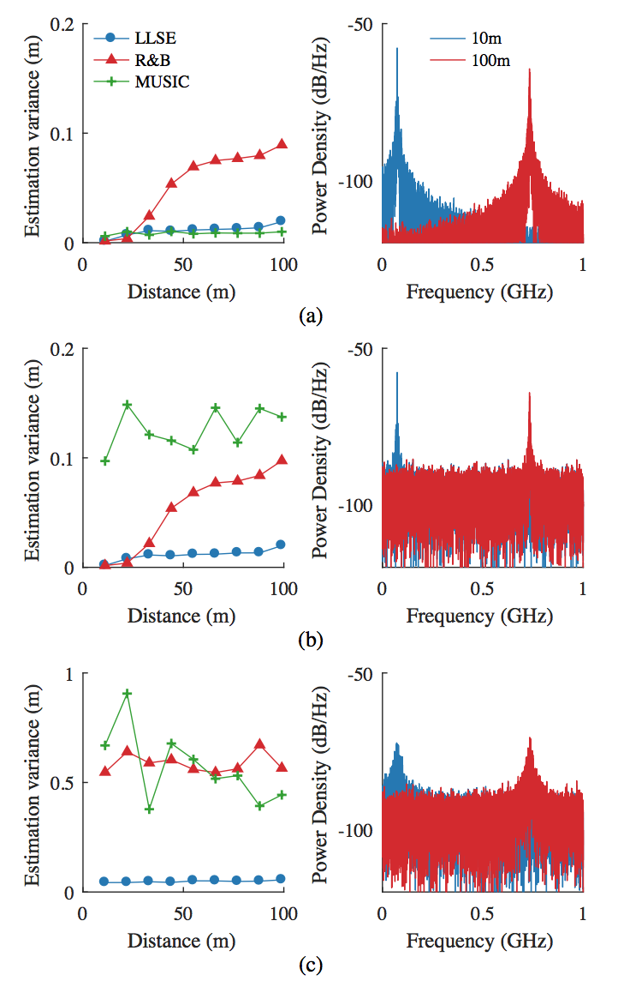
Phase noise problem: improved algorithm
Linewidth=1MHz, T=10us, Prx=1mW
Linewidth=1MHz, T=10us, Prx=1nW
Linewidth=10MHz, T=10us, Prx=1nW
Notes:
S_i(f) = \frac{{i_0}^2}{2}\left[ \frac{{\tau}_c/(2\pi)}{1+\left(\pi f {\tau}_c \right)^2} \left\{ 1- e^{-\frac{2\tau}{{\tau}_c}} \left[ \cos(2\pi f\tau) + \frac{1}{\pi f \tau_c} \sin(2\pi f \tau) \right] \right\} \right]
\tau_c = \frac{2}{\textrm{linewidth}},\quad i_0: \textrm{nominal photocurrent amplitude},\quad \tau: \textrm{path delay}

Slide 9
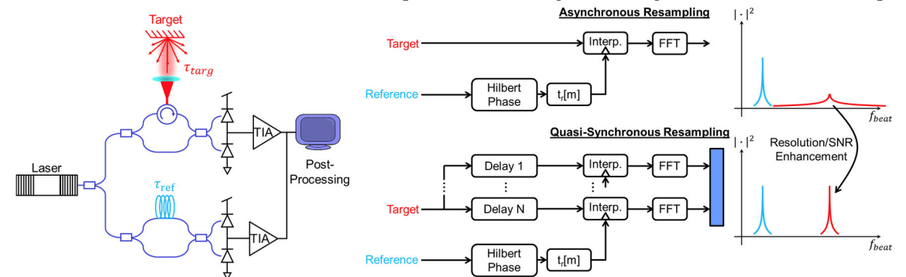
Experimental Demonstration
~100GHz, 10us chirping using DBR laser from Ming’s lab
Nonlinearity in modulation
Measured/Calibrated using resampling [Sandborn ‘17]
Resampling points generated from reference arm with ~10cm path difference

Slide 10
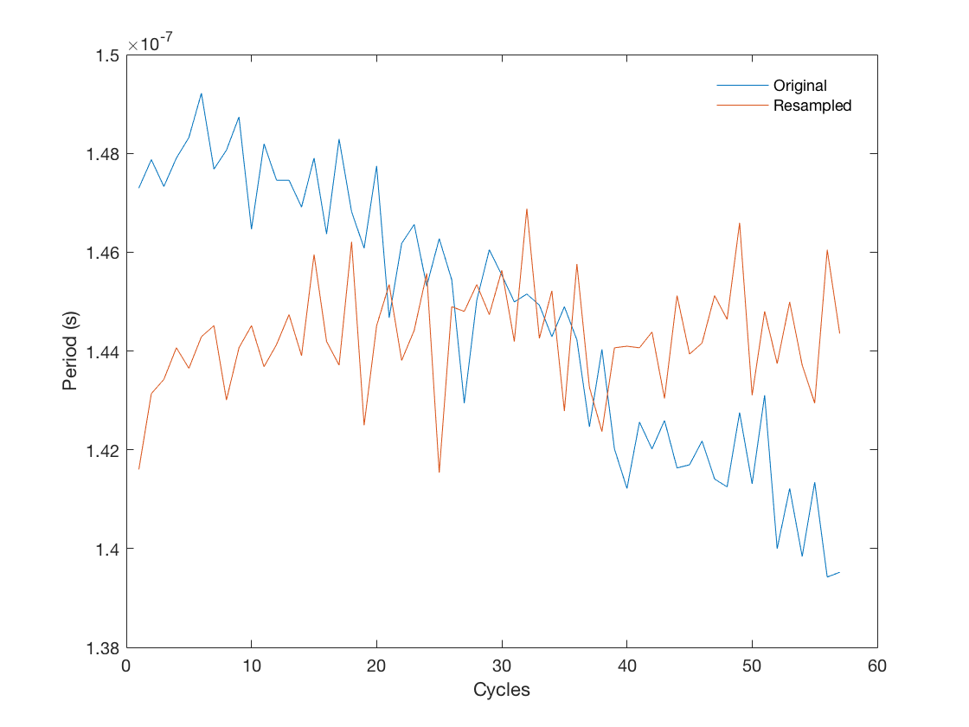
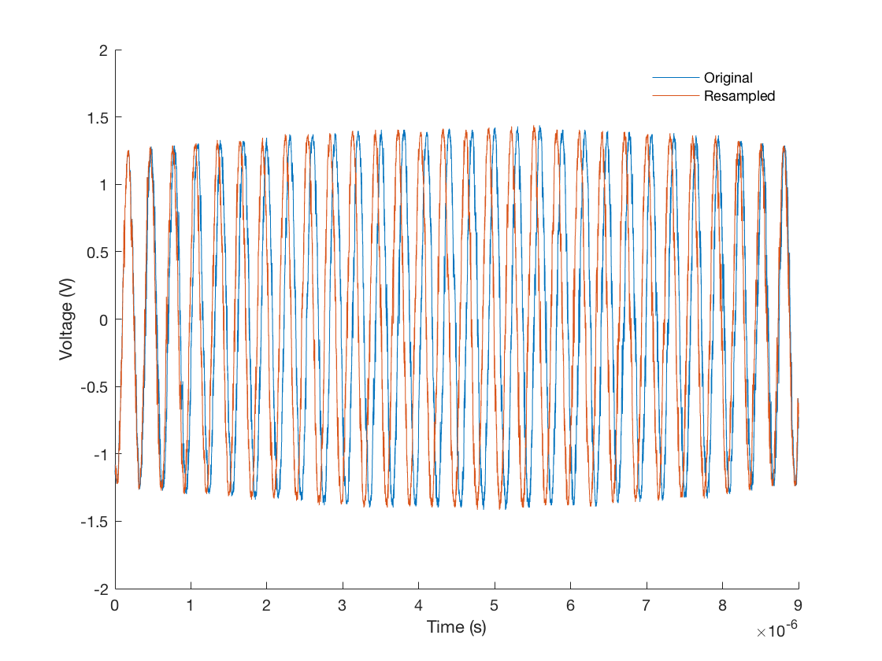
Experimental Demonstration
Measured chirping nonlinearity
Periods
Time-domain waveform

Slide 11
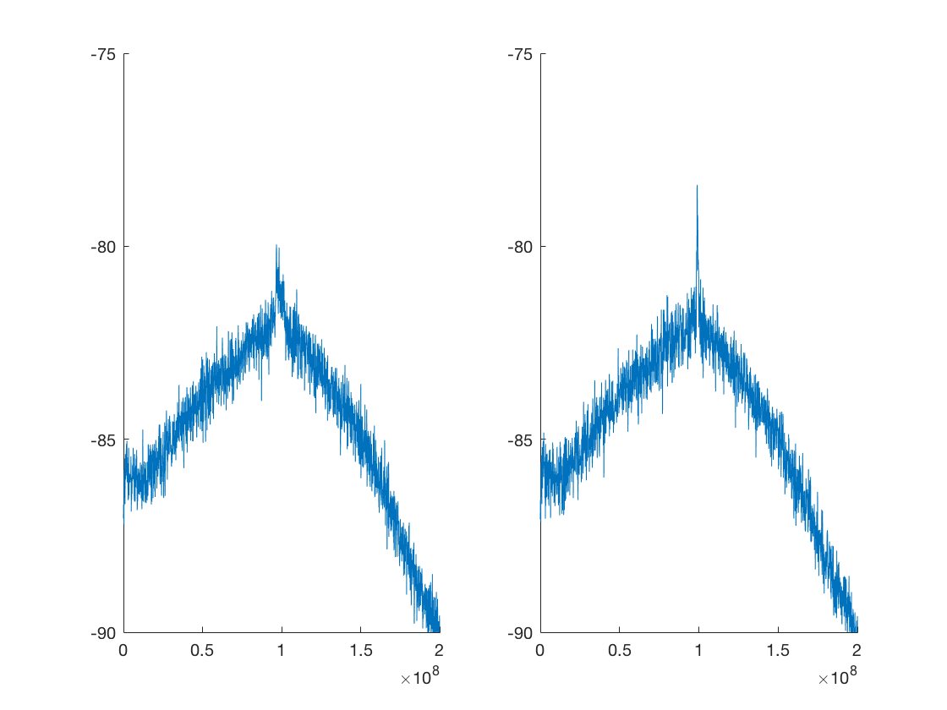
Experimental Demonstration
Nonlinearity correction for 1.5m sample

Slide 12
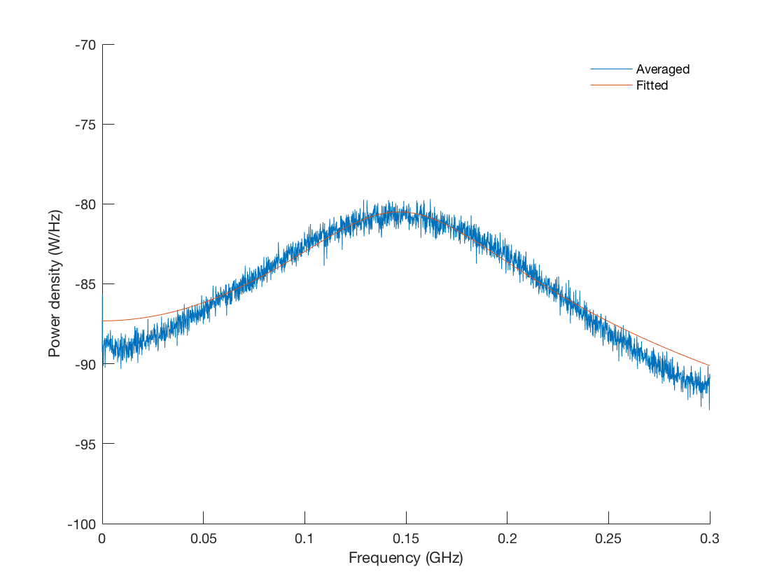
Experimental Demonstration
How close is the Lorentzian model to the actual measurement?

Slide 13
Experimental Demonstration
Lorenztian LSE: 1.5m sample
PER: sigma = 24.8cm
LLSE: sigma = 2.27cm

Slide 14
Experimental Demonstration
Lorenztian LSE: 2.2m sample
PER: sigma = 27.3cm
LLSE: sigma = 2.19cm

Slide 15
End-to-end system model including algorithm
(Max range, RF bandwidth)
T=10us
300m, 1GHz
Chirp: 5GHz
Chirp: 10GHz
Chirp: 10GHz
For 5cm accuracy target, 300m, 1GHz does not work with 10MHz linewidth
By increasing RX bandwidth, chirp BW can be increased -> better perform.
By reducing maximum range, chirp BW can be increased & more coherent
Notes:
S_i(f) = \frac{{i_0}^2}{2}\left[ \frac{{\tau}_c/(2\pi)}{1+\left(\pi f {\tau}_c \right)^2} \left\{ 1- e^{-\frac{2\tau}{{\tau}_c}} \left[ \cos(2\pi f\tau) + \frac{1}{\pi f \tau_c} \sin(2\pi f \tau) \right] \right\} \right]
\tau_c = \frac{2}{\textrm{linewidth}},\quad i_0: \textrm{nominal photocurrent amplitude},\quad \tau: \textrm{path delay}

Slide 16
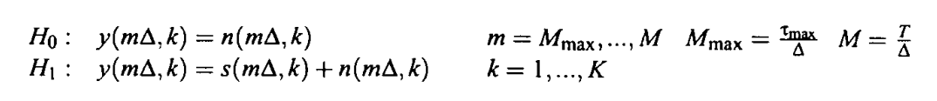
For really long distance measurement
If now the goal is not to find out the position of the target, but to just find out if there is something within spectral ROI, SNR constraint could be less stringent
T=1ms
Distance=1km
Linewidth=100kHz
Chirp bandwidth=5GHz
Number of MC samples=100
Notes:
S_i(f) = \frac{{i_0}^2}{2}\left[ \frac{{\tau}_c/(2\pi)}{1+\left(\pi f {\tau}_c \right)^2} \left\{ 1- e^{-\frac{2\tau}{{\tau}_c}} \left[ \cos(2\pi f\tau) + \frac{1}{\pi f \tau_c} \sin(2\pi f \tau) \right] \right\} \right]
\tau_c = \frac{2}{\textrm{linewidth}},\quad i_0: \textrm{nominal photocurrent amplitude},\quad \tau: \textrm{path delay}

